Slide 1
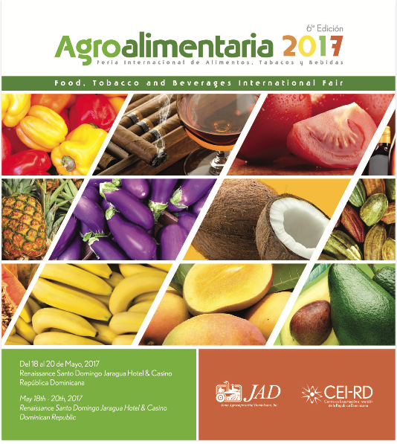
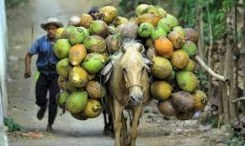
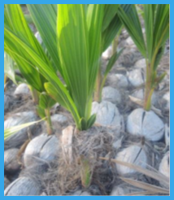
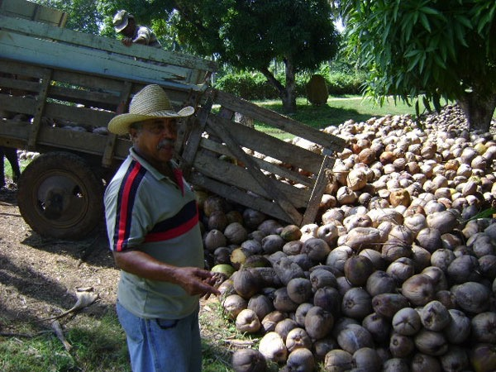
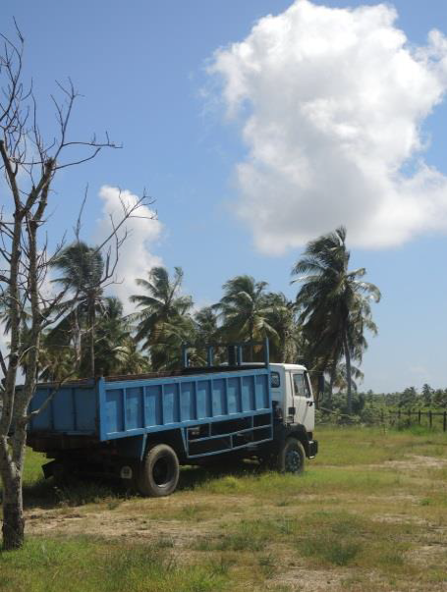
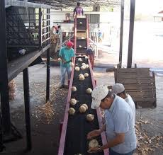
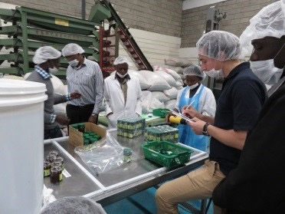
Alianzas para el Desarrollo Inclusivo del Sector Coco: Tendencias de Mercado, Potencial y Perspectivas.
Agroalimentaria
May 19th, 2017

Slide 2
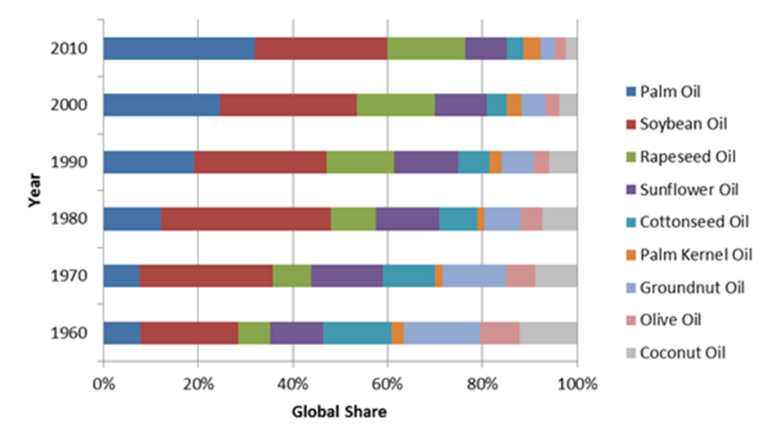
Global Market Trends: Coconut Products
No longer a vegetable oil commodity
RBD coconut oil: stagnation 3-4MMT, market share from12% to just below 3%
Niche market:
‘naturalness’ in cosmetics, personal care, and detergent markets
Competing only with palm kernel oil
Virgin Coconut Oil:
Scale independent
Favorable environmental and health profile
Premium price
Global Market Share: Nine Major Vegetable Oils (1960-2010)
Source: APCC, Frost & Sullivan

Slide 3
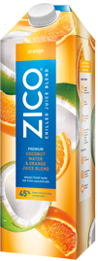
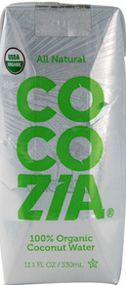
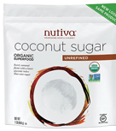
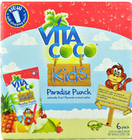
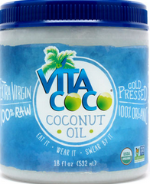
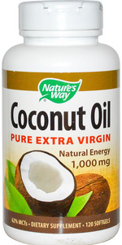
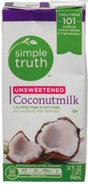
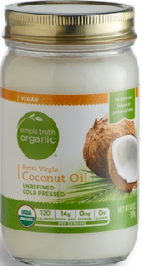
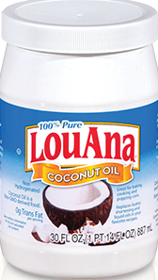
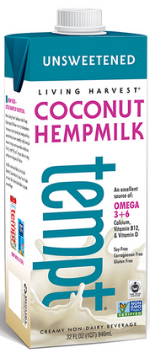
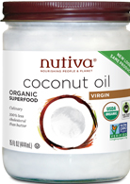
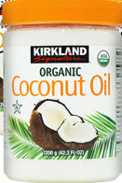
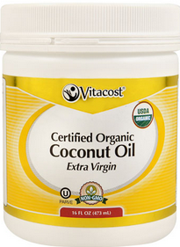
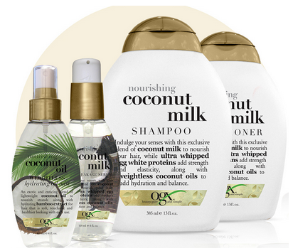
Global Market Trends: Coconut Products (Cont’d)
Marketing strategy of lead firms boosted consumer awareness and demand for coconut products
Coconut water
US$1.86 billion in 2015
25% per year growth to US$4 billion in 2019
Pepsi (Kero Coco, O.N.E, Tropicana Coco Quench), Coca-Cola (Zico), & Vita Coco
Alternative dairy (almond, soy, & coconuts)
US$1.99 billion in 2015
18% per year growth to US$6.27 billion in 2021
WhiteWave Foods Inc., Blue Diamond Growers Inc., Living Harvest Foods Inc.
Other products: coconut sugar, flour, VCO.

Slide 4
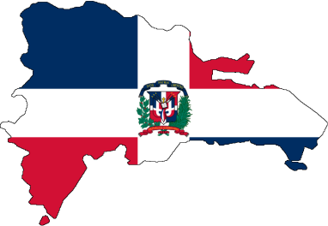
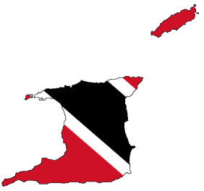
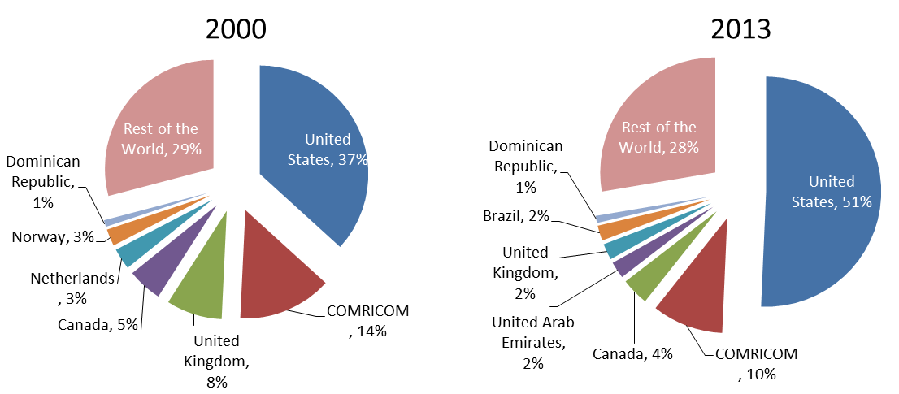
Emerging Regional Coconut Value Chain
Primary Processing
Advanced Processing
Manufacturing
End Market
Production
Markets:
United States, and Dominican Republic (< 10%)
US$4.7million in 2014
(Coconuts)
Dominican Republic processes
coconuts into grated, cream and milk
US$0.7 million in 2014 (CNO)
US$106 thousand in 2014 (Coconuts)
Refined Coconut Oil Markets:
St. Lucia (US$1.14 million); Jamaica (US$1.53 million); Antigua and Barbuda, Dominica, St. Vincent and the Grenadines
Guyana
Supplied approximately US$6 million coconuts and products to Dominican Republic, Trinidad, and other countries in the region
Non-oil Merchandize Exports, Nine Caribbean Countries
Trinidad refines coconut oil and exports under different business relations to the countries in the region
(US$2.7 million export in 2014)

Slide 5
Lead Firms and Governance: Brand Manufacturers
Cosmetics, Personal & Home Care, Pharmaceuticals
Firm | HQ | Annual Sale
 | U.S. | 83
 | France | 30
 | U.K. | 64
 | U.S. | 17
 | Germany | 8
Packaged Food
Firm | HQ | Annual Sale
 | Switzerland | 100
 | U.S. | 34
 | U.S. | 67
 | U.K. | 64
 | France | 26
Beverages (Health & Wellness)
Firm | HQ | Annual Sale
 | U.S. | 46
 | U.S. | 67
 | Switzerland | 100
 | France | 26
 | Austria | 6
Note: 2014 sale figures in US$ billion
Multiple business segments, focused on sustainability initiatives, naturally-derived ingredients, not an exclusive focus on ingredient certification
Mondelez International, launched in 2012, a 10-year commitment US$400 million program that finances sustainability partnerships. In India, it supported intercropping in coconut plantations, working with 100,000 coconut farmers in four states

Slide 6
In-country Main Constraints
Domestic seedling supply is either non-existent or at best the waitlist takes years to access the desired number and variety of seedlings
Risk of lethal yellowing, red ring, red palm mite prevail across the region although with some variations
Tailored financial services to smallholder farmers is a common challenge across the countries.
Access Planting Material & finance & Services
Unavailability of reliable industry statistics about the plantations, age-profile, production capacity, and trade is a major source of investment risk
Despite its rising contribution to the agricultural GDP of the target countries, coconut industry does not have priority policy support.
Lack of Statistics & legacy of ‘copra oil’ era
Better leverage capabilities of CARDI & regional universities
A predominantly fragmented industry structure (weak value chain linkages) and smallholder dominated farming system
High transaction costs and scale inefficiencies in delivery of key services –market information, technical extension, quality control and finance
Weak standardization and certification of the non-traditional products
Small structure and weak end-market presence limits flow of consumer market information to the local industry stakeholders and feed into the weak market intelligence and export promotion.
Few Incentives for smallholder market integration and low income generation
Weak Industrial organization and no support to smallholders

Slide 7
Caribbean Coconut Regional and Global Value Chain
Agroalimentaria
May 19th, 2017

Slide 8
Coconut Value Chain: Input-Output Structure
Primary Processing
Advanced Processing
Manufacturing
End Market
Inputs
Production
De-husked nuts
Virgin coconut oil
Desiccated coconut
Coconut milk & cream
Household consumption
Baking, alternative dairy, and confectionery industries
Finance
Coconut Kernel
Research & Development
Land
Mature Coconuts
RBD coconut oil
Water
Seedlings
Dried Kernel Copra
Crude coconut oil
Oleochemical (Fatty Acids, Fatty Alcohols, Glycerin)
Cosmetics
Personal care
Pharmaceuticals
Detergents
Agrochemicals
Copra Cake
Coconut husk
Biodiesel
Coconut shell
Processed & packaged coconut water & various flavors
Local fresh water
Pasteurized & packaged coconut water (sports & natural drinks)
Legend:
Tender Coconuts
Coconuts-food chain
Bottled coconut water
Coconuts-chemicals chain
Coconuts-’sports drink’ chain
Coconut coir & pith
Natural fiber composites
Geotextile products
Horticulture
Construction
Automotive
Coconut-coir Chain
Coconut-activated carbon chain
By-products
Charcoal & activated carbon
Air & water filtration
Institutions:
1) Country Level: Coconut Board/Authority/Associations; Coconut Research Institutes; Ministries of Agriculture; Ministry of Trade & Industry; and Bureaus of Standards
2) Regional/Global Level: Asia Pacific Coconut Community; and Coconut Genetic Resources Network

Slide 9
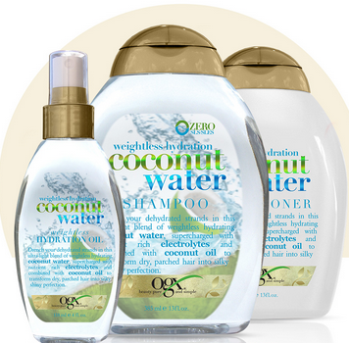
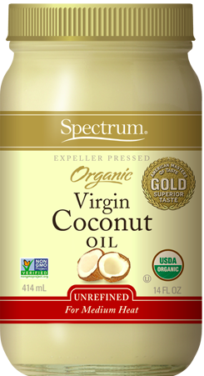
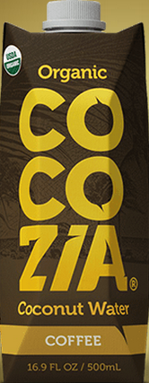
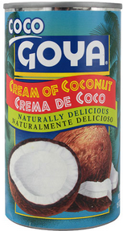
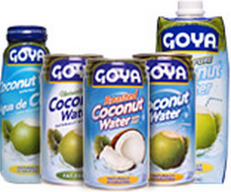
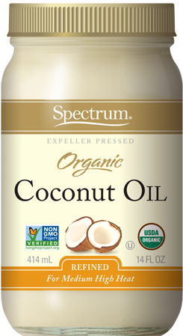
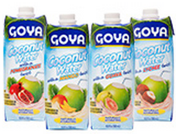
Lead Firms and Governance: Brand Manufacturers
Firm | HQ | Annual Sale | Industry (Brand)
 | U.S. | 2,500 | Packaged Food (LouAna)
 | U.S. | 2,150 | Packaged Food (Spectrum)
 | U.S. | 1,000 | Packaged Food & Beverage (Goya)
 | U.S. | 250 | Coconut Water, Coconut Oil (VitaCoco)
 | U.S. | 90 | Coconut Oil (nutiva)
 | U.S. | 9 | Packaged Food & Beverages (COCOZIA, EPICUREX)
 | U.S | 1.2 | Personal Care (Oxy)
 | U.S. | N/A | Nutraceutical (Nature’s Way)
Single segment and/or niche market brand manufacturers
Focused on ingredient and end-product certification
Note: 2014 sale figures in US$ million
Source: Euromonitor, PrivCo, OneSource

Slide 10
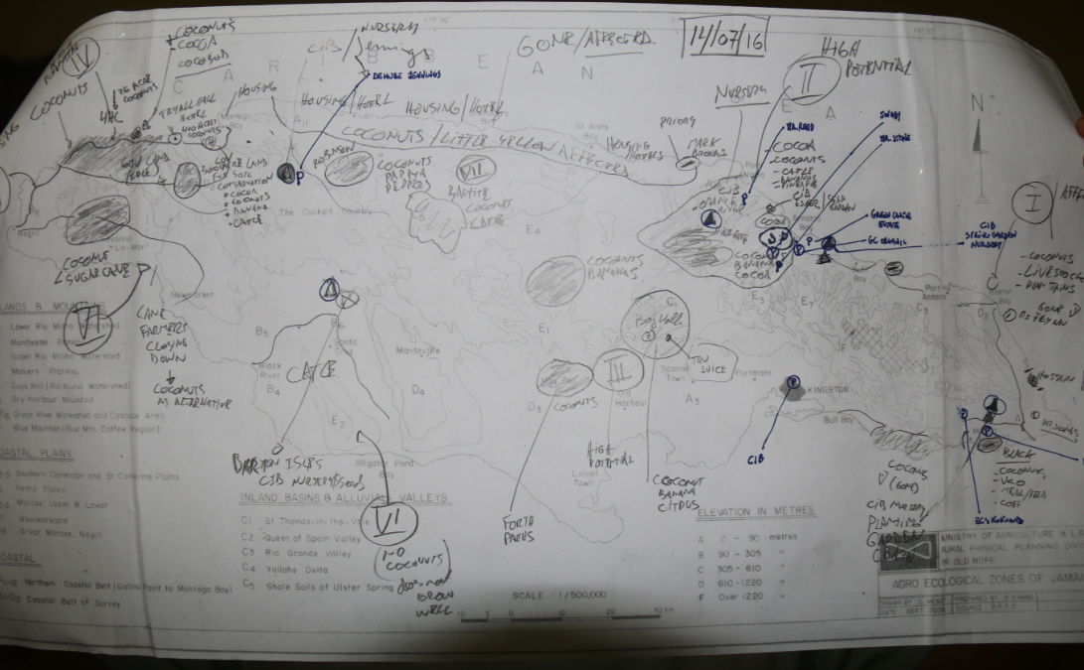
Selection of Alliance locations in Jamaica

Slide 11
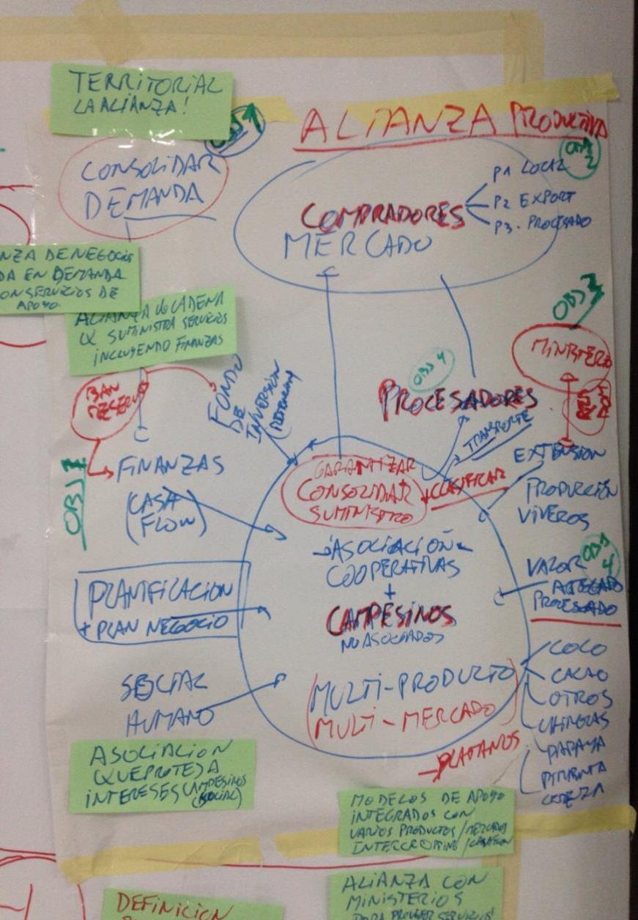
Alliances for Action Model (A4A) for project implementation
A4A are partnerships for implementation at the local level
Not just Coconuts but associated crops: Fruits, Vegetables, etc.
Voluntary network of partners from along the agricultural supply chain into a Value Chain Alliance to jointly implement local level market-led solutions.
Generate new opportunities for farmers and entrepreneurs, while increasing trade, diversification, food security and sustainability as a way to drive social and economic impact.
Business and value chain alliances for improved business for all targeting coconuts and associated crops

Slide 12
Participatory workshop validating model
Summary of KEY ISSUES FOR THE COCONUT SECTOR AT THE NATIONAL LEVEL
A | Lack of information on business models, market information, opportunities and linkages
B | Disorganised sector and fragmented value chains
C | Limited access to quality planting material and R&D
D | Limited access to finance and investment
E | Poor value addition and product development; and poor compliance to processing, food safety and quality standards
F | Poor productivity, coordination and access to extension services at the farm level
G | Lack of policy support and alignment of policies to support the sector

Slide 13
The Roadmaps: Regional and National
Business models and market information
Establish commercially driven value chain alliances and improve organization of the sector
R&D and Quality planting material availability
Access to finance and investment
Value addition and product development; processing, food safety and quality standards
Productivity, coordination and extension
Policy Support and alignment

Slide 14
Alianzas para el Desarrollo Inclusivo del Sector Coco: Tendencias de Mercado, Potencial y Perspectivas.
Agroalimentaria
May 19th, 2017

